Slide 1
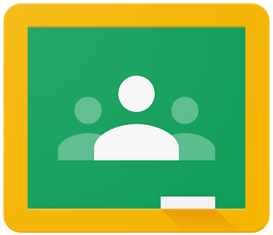
Guidance for Students: Locating and Submitting Google Classroom Assignments

Slide 2
Accessing Your Assignments
Go to the CLASSWORK page in your Google Classroom
View your work
Open your assignment

Slide 3
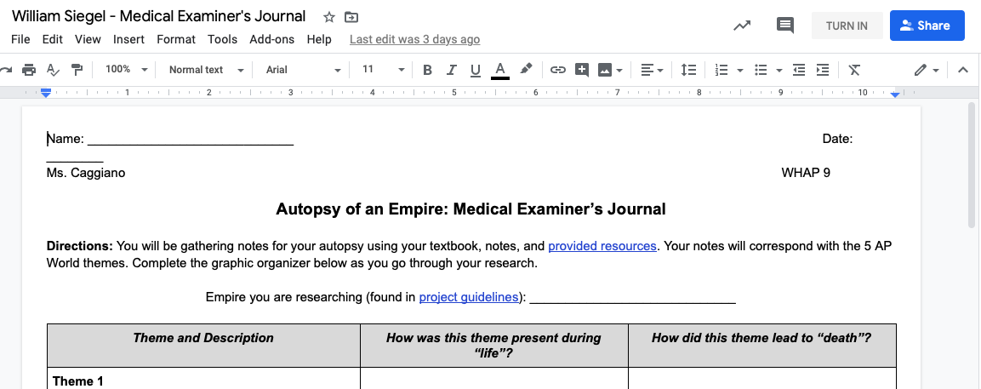
Turning in Your Assignments
Complete your assignment and TURN IT IN!!!!!

Slide 4
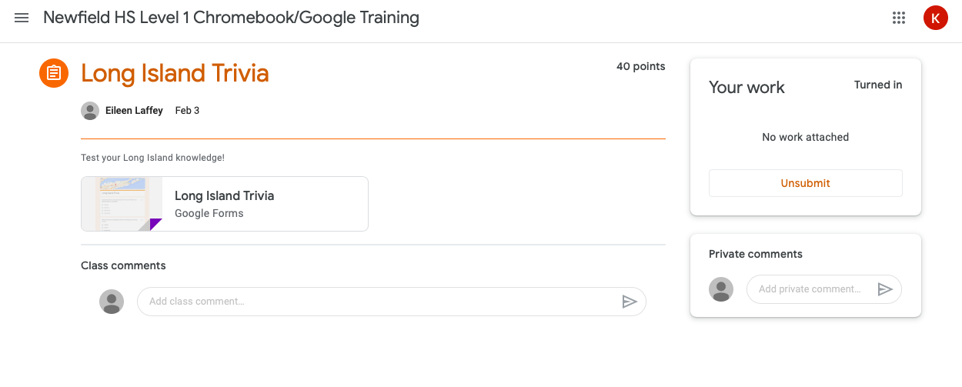
Turning in Your Assignments
If you realized you made a mistake and want to modify your assignment, click “Unsubmit,” make your change, and “Turn In” your assignment again.

Slide 5
Troubleshooting
The work was not posted as a assignment and I cannot change the Google Doc or Slides attachment.
Go to “File” and “Make a Copy”
It will save to your Google Drive and you should be able to open and edit it
Suggestion: Update the file name to include your name and the assignment title
Ready to submit? Go the the assignment in Google Classroom in Classwork
Choose option to “+Add or create” and locate the file in Google Drive
Select the document and add
Once the attachment appears under “Your work” you can click “Turn in”

Slide 6
Troubleshooting
The work was not posted as a assignment and I cannot change the Microsoft Word or Powerpoint attachment.
Open the attachment and at the top of the document you should see an “Open with” option
Click to open as Google Doc or Slides
It will save to your Google Drive and you should be able to open and edit it
Suggestion: Update the file name to include your name and the assignment title
Ready to submit? Go the the assignment in Google Classroom in Classwork
Choose option to “+Add or create” and locate the file in Google Drive
Select the document and add
Once the attachment appears under “Your work” you can click “Turn in”

Slide 7
Troubleshooting
The assignment is a PDF attachment.
NOTE: Your teacher may have given separate instructions for using a PDF program such as Kami or the option to upload a picture of your work. Follow those instructions or:
Open a blank Google Doc
Be sure to title the assignment and include your name (you should include this information in the file name too)
Use this Doc as an answer sheet to record your responses to the questions or activities on the PDF
Ready to submit? Go the the assignment in Google Classroom in Classwork
Choose option to “+Add or create” and locate the file in Google Drive
Select the document and add
Once the attachment appears under “Your work” you can click “Turn in”

Slide 8
We hope this helps!!!!
Do not hesitate to email your teacher if you are having any difficulty!

